Slide 1

Calculating the Screen time of An Actor in a Video using Deep Learning
Presented By :
Abhish Ijari
Rakshita Raghava Shetty

Slide 2

Contents: Introduction Key Frame Extraction Methodology Issues and Challenges Conclusion References

Slide 3

INTRODUCTION
In Video analysis extracting relevant information is a mandatory task
Key Frame extraction is a primary step of computer vision algorithm
In many computer vision applications such as content-based video retrieval (CBVR), video scene analysis and video sequence summarization is mandatory to analyze the overall video structure

Slide 4

KEY FRAME EXTRACTION
Some Web sites use HTML frames - Where the pages are broken up into various areas. Each area consists of an independent Web page.
Graphics and desktop publishing programs - In these programs, frames are rectangular areas meant for inserting graphics and text.
In video and animation - Frames are individual pictures in a sequence of images. For example, a Flash movie you see on the Web may play 12 frames per second, creating the appearance of motion

Slide 5
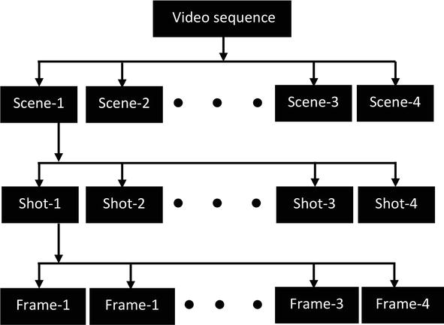
Fig : Structure of a Video

Slide 6
Key frame size Estimation methods
Priori knowledge base as a fixed number :
Kr = {Fi1,Fi2,Fi3,…..Fik} E1
Specific summarization of key frames is defined by Eq. (2):
{Kf1,Kf2,Kf3,….Kfk} = ∑1nminri{Dist(Kr,V,δ)} E2
where,
1 ≤ ri ≥ n

Slide 7
Posteriori knowledge base as unknown :
{Kf1,Kf2,Kf3,….Kfk} = ∑1nminri{K|Dist(Kr,V,γ)} E3
Determined-fixed number
the number of key frames is predetermined before the whole process key frame extraction process

Slide 8
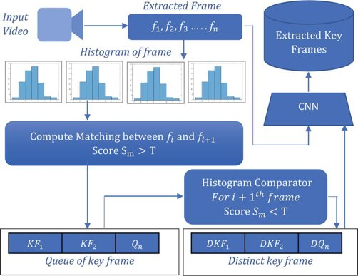
METHODOLOGY
Fig : Proposed framework for key frame extraction

Slide 9
Video reading from database
Vi={V1,V2,V3,….Vk} E4
Frame extraction from video
Fi={F1,F2,F3,….Fn} E5
Preprocessing of frames
Histogram generation
Hn = number of pixels with intensity
total number of pixels

Slide 10
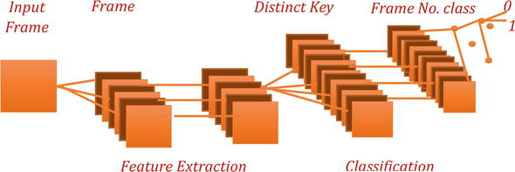
Key frame extraction using a convolution neural network

Slide 11


ISSUES AND CHALLENGES
1. Illumination challenges - Sudden changes in lighting may lead to false positive object detection
2. Changes in the appearance of moving objects - All objects are three-dimensional in real life, and they may change their appearance when in motion

Slide 12
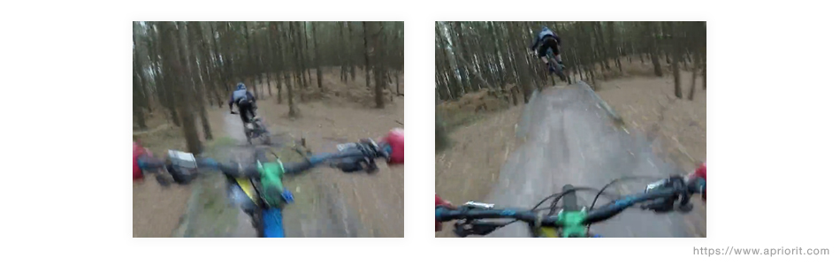
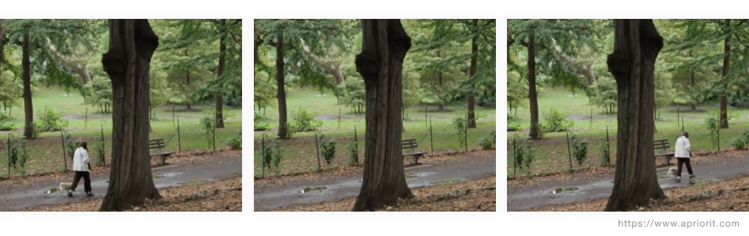
3. Presence of unpredicted motion - When it comes to traffic surveillance, there’s a problem of detecting objects with abrupt motion
4. Occlusion - Occlusions can also make it much more difficult to detect and track moving objects in a video

Slide 13
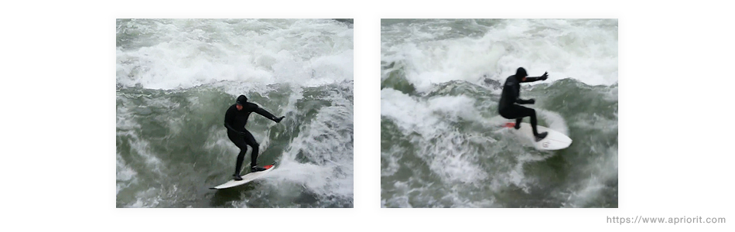

5. Complex backgrounds - Natural outdoor environments may be too complex for many moving object detection algorithms
6. Moving shadows - These shadows also move, and they’re difficult to distinguish from the moving objects that cast them

Slide 14
CONCLUSION
Got an accuracy of around 88% on the validation data and 64% on the test data using this model
Reason for low accuracy on test data could be lack of training data
Once the model has seen a plethora of images of these two characters, there’s a good chance it will lead to a better classification result.

Slide 15
REFERENCES
https://www.intechopen.com/books/recent-trends-in-computational-intelligence/deep-learning-approach-to-key-frame-detection-in-human-action-videos
https://www.analyticsvidhya.com/blog/2018/09/deep-learning-video-classification-python/
Gargi U, Kasturi R, Strayer SH. Performance characterization of video-shot-change detection methods. IEEE Transactions on Circuits and Systems for Video Technology (TCSVT). 2000;10(1):1-13

Slide 16
THANK
YOU

